Slide 1
AZ-203.2 Module 03: Create Azure App Service API apps
Subtitle or speaker name
Notes:
In this module, you will cover:
Creating API Management Solutions
Using Swagger to Document an API App

Slide 2
Topics
Azure API Apps
Creating API Management solutions
Using Swagger to document an API app
Notes:
These are the topics that will be covered in this module.

Slide 3
Lesson 01: Azure API Apps
Notes:
In this lesson, you will cover:
API Apps
Integrations
Authentication
CORS

Slide 4
Azure API Apps
Similar functionality to Azure Web Apps
Integrated with Azure Logic Apps and API Management
Supports built-in authentication
Supports built-in cross-origin resource sharing (CORS) request handling
Notes:
Azure API Apps is a "sibling" service within Azure App Service that shares much of the same functionality as Azure Web Apps. Like Web Apps, API Apps has support for built-in authentication and cross-origin resource sharing (CORS) request handling. API Apps also support direct integration with other Azure services such as Logic Apps and API Management.

Slide 5



Integrations
Logic apps
API apps
API Management
Notes:
API apps are available to use as actions in an Azure Logic app, or back-end APIs in Azure API Management. With API Apps, you can deploy your back-end APIs to a single location and re-use them throughout multiple application components.

Slide 6


Authentication
Built-in to service:
Requires minimal or no code
Handled in an external module:
Authentication is managed before requests get to your application code
The module handles:
Authenticating users
Tokens
Sessions
Headers
API app
Code
Azure Active
Directory
Notes:
Azure App Service provides built-in authentication and authorization support, so that you can sign in users and access data by writing minimal or no code in your API.
The authentication and authorization module runs in the same sandbox as your application code. When it's enabled, every incoming HTTP request passes through it before your application code handles it.
For your app, this module:
Authenticates users with the specified provider
Validates, stores, and refreshes tokens
Manages the authenticated session
Injects identity information into request headers
The module runs separately from your application code. You can configure it by using app settings. It does not require SDKs, specific languages, or changes to your application code.

Slide 7


CORS
Mechanism for servers to indicate that they support cross-site requests
Servers can specify:
Allowed HTTP verbs
Allowed origins
Allowed headers
Directly supported by API Apps
1
Options
2
Access Control
3
Actual Request
Notes:
Browser security prevents a web page from making requests to a different domain than the one that served the web page. This restriction is called the same-origin policy. The same-origin policy prevents a malicious site from accessing sensitive data on another site.
Sometimes, you might want to allow other sites make cross-origin requests (CORS) to your app. CORS is a Worldwide Web Consortium (W3C) standard that allows a server to relax the same-origin policy.
In a standard CORS implementation, the JavaScript client will send a pre-flight request by using an OPTIONS verb to assess the server's willingness to accept a cross-site request. If allowed, the JavaScript client will then issue a cross-site HTTP request.

Slide 8
Lesson 02: Creating API Management solutions
Notes:
In this lesson, you will cover:
API Management
Terminology
Service hierarchy
Products
Policies
Application gateway

Slide 9
API Management (APIM)
Streamlines the process of common tasks necessary for creating an API for external use
Tasks include:
Creating a successful and useful developer portal
Securing API endpoints from anonymous or unwanted access
Managing existing developer access through cache mechanisms, throttling, and other policies
Building a monitoring and analytics platform to diagnose issues and monitor adoption
Providing business users and developers with deep insights into how each API is specifically used
Notes:
API Management (APIM) helps organizations publish APIs to external, partner, and internal developers to unlock the potential of their data and services. Businesses everywhere are seeking to extend their operations as a digital platform, creating new channels, finding new customers, and driving deeper engagement with existing ones. API Management provides the core competencies to ensure a successful API program through developer engagement, business insights, analytics, security, and protection. You can use Azure API Management to take any backend and launch a full-fledged API program based on it.

Slide 10
Terminology
Backend API
A HTTP service that you implement with your business logic
Frontend API
A HTTP service façade hosted by API Management to obfuscate your back-end API
Product
One or more APIs, along with a usage quota and terms of use
Operation
A specific operation in the front-end API that correlates to a specific request/response from the backend API
Notes:
Backend API
An HTTP service that implements your API and its operations.
Frontend API/APIM API
An APIM API does not host APIs, it creates facades for your APIs to customize the facade according to your needs without touching the back-end API.
APIM product
A product contains one or more APIs as well as a usage quota and the terms of use. You can include several APIs and offer them to developers through the developer portal.
APIM API operation
Each APIM API represents a set of operations available to developers. Each APIM API contains a reference to the back-end service that implements the API, and its operations map to the operations implemented by the back-end service.

Slide 11
Terminology (continued)
Version
A breaking change to the front-end API
Existing application will not be required to change its code as you update or change the front-end API
Revision
A non-breaking change to a front-end API
Developer portal
An interface that developers use to learn about your API and test operations
Notes:
Version
Sometimes you want to publish new or different API features to some users, while others want to remain with the API that currently works for them.
Revision
When your API is ready to go and starts to be used by developers, you usually need to take care in making changes to that API and at the same time not to disrupt callers of your API. It's also useful to let developers know about the changes you made.
Developer portal
Your customers (developers) should use the developer portal to access your APIs. The developer portal can be customized.

Slide 12
Demo: Create an Azure API Management service instance
Notes:
API Management provides the core competencies to ensure a successful API program through developer engagement, business insights, analytics, security, and protection. APIM enables you to create and manage modern API gateways for existing back-end services hosted anywhere.
This revision of the course does not ship with demo instructions. For each demo, you will be given a list of specific tasks you should demonstrate to your students. The flow, content and structure of your demo is left to you to decide as an instructor.
In this demo, you should show students how to:
Create a new API Management instance
Observe the developer and publisher portals

Slide 13
Service hierarchy
Create and manage APIs
Each API contains one or more sets of operations
Operations are configurable, granting control over:
URL mapping
Query and path parameters
Request and response content
Operation response caching
Operation (HTTP GET)
API
(Internal API)
Operation (HTTP POST)
Service (API Management)
API
(Third-party API)
Operation (HTTP GET)
Notes:
Each service instance has one or more APIs that contain one or more operations.

Slide 14
Demo: Create a new API
Notes:
This tutorial shows how to use the Azure portal to add an API manually to the API Management (APIM) instance that you created earlier. Mocking the API is a common scenario where you would want to create a blank API and define it manually.
This revision of the course does not ship with demo instructions. For each demo, you will be given a list of specific tasks you should demonstrate to your students. The flow, content and structure of your demo is left to you to decide as an instructor.
In this demo, you should show students how to:
Create a new blank API
Add API endpoints

Slide 15
Products
Contains one or more APIs in a package
Products can be open or protected
Open products are free to use without any subscription
Protected products must be subscribed to before use
When a product is ready for developers, it can be published for use
Notes:
Products are associations of one or more APIs. You can include a number of APIs and offer them to developers through the developer portal. You can add an existing API during the product creation. You can add an API to the product later, either from the Products Settings page or while creating an API.
Developers must first subscribe to a product to get access to the API. When they subscribe, they get a subscription key that is good for any API in that product. If you created the APIM instance, you are an administrator already, so you are subscribed to every product by default.

Slide 16
Demo: Create and publish a product
Notes:
In Azure API Management, a product contains one or more APIs, and a usage quota and the terms of use. After a product is published, developers can subscribe to the product and begin to use the product's APIs.
This revision of the course does not ship with demo instructions. For each demo, you will be given a list of specific tasks you should demonstrate to your students. The flow, content and structure of your demo is left to you to decide as an instructor.
In this demo, you should show students how to:
Create a new product with a terms of use statement and usage quotas
Associate an API with the newly created product

Slide 17
Policies
Collection of statements that are executed sequentially at the request or response of an API
A quick way to change the behavior of an API without code changes to the actual back-end API application
A comprehensive list of policy options can be found at Microsoft Docs “API Management policies”
(https://aka.ms/AA4gbi5)
Notes:
In Azure API Management (APIM), policies are a powerful capability of the system that allow the publisher to change the behavior of the API through configuration. Policies are a collection of statements that are executed sequentially on the request or response of an API. Popular statements include format conversion from XML to JSON and call rate limiting to restrict the amount of incoming calls from a developer. Many more policies are available out of the box.

Slide 18
Application Gateway
Enables management of traffic to your web applications
Operates as a web traffic load balancer, which allows for more specific traffic routing than a traditional load balancer
Can handle additional scenarios such as:
Custom routing
Session affinity
SSL termination
Firewall management
Redirection
Notes:
Azure Application Gateway is a web traffic load balancer that enables you to manage traffic to your web applications by routing based on more criteria than a traditional load balancer (OSI layer 4). This type of routing is known as application layer (OSI layer 7) load balancing. Azure Application Gateway can do URL-based routing and more.

Slide 19




Application Gateway (continued)
ImageServerPool
Application
Gateway
/images/*
Contoso.com
WAF
VideoServerPool
/video/*
L7 LB
Notes:
Traditional load balancers operate at the transport layer (OSI layer 4 - TCP and UDP) and route traffic based on source IP address and port, to a destination IP address and port.
With the Application Gateway, you can be even more specific. For example, you can route traffic based on the incoming URL. So if /images is in the incoming URL, you can route traffic to a specific set of servers (known as a pool) configured for images. If /video is in the URL, that traffic is routed to another pool optimized for videos.

Slide 20
Lesson 03: Using Swagger to document an API app
Notes:
In this lesson, you will cover:
Swashbuckle.
Configuring Swagger middleware.
Documenting the object model.
XML comments.
Model attributes.
Response descriptions.

Slide 21
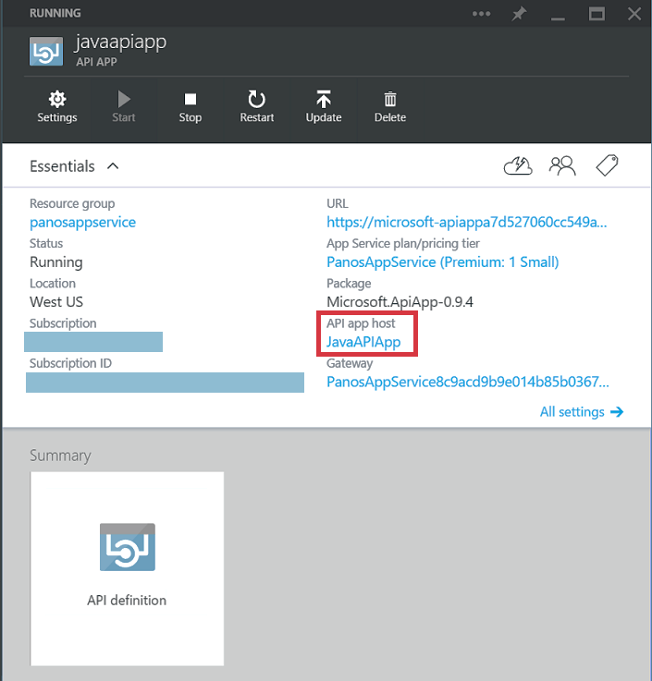
API Apps
Quickly implement custom APIs:
Publish to external, partner, and internal developers
Extend operations for data and services
Each API can have one or more operations
API Apps can be integrated into Logic App workflows
Notes:
Quick way to build and consume APIs in the cloud by using the same flexibility as a web app.

Slide 22
Swashbuckle
Installed by using NuGet packages
Swashbuckle.AspNetCore.Swagger
Swagger object model and middleware to expose SwaggerDocument objects as JSON endpoints
Swashbuckle.AspNetCore.SwaggerGen
Swagger generator that builds SwaggerDocument objects directly from your routes, controllers, and models
Typically combined with the Swagger endpoint middleware to automatically expose Swagger JSON
Swashbuckle.AspNetCore.SwaggerUI
Embedded version of the Swagger UI tool
Interprets Swagger JSON to build a rich, customizable experience for describing the Web API functionality
Includes built-in test harnesses for the public methods
Notes:
This section of the course focuses on Swashbuckle to generate Swagger objects in ASP.NET Core.
There are three main components to Swashbuckle:
Swashbuckle.AspNetCore.Swagger
A Swagger object model and middleware to expose SwaggerDocument objects as JSON endpoints.
Swashbuckle.AspNetCore.SwaggerGen
A Swagger generator that builds SwaggerDocument objects directly from your routes, controllers, and models. It's typically combined with the Swagger endpoint middleware to automatically expose Swagger JSON.
Swashbuckle.AspNetCore.SwaggerUI
An embedded version of the Swagger UI tool. It interprets Swagger JSON to build a rich, customizable experience for describing the Web API functionality. It includes built-in test harnesses for the public methods.

Slide 23
Configure Swagger middleware
public void ConfigureServices(IServiceCollection services)
{
services.AddMvc();
services.AddSwaggerGen(c =>
{
c.SwaggerDoc(
"v1",
new Info { Title = "My API", Version = "v1" }
);
});
}
Notes:
In ASP.NET Core, add the Swagger generator to the services collection in the Startup.ConfigureServices method.

Slide 24
Configure Web App to use Swagger middleware
public void Configure(IApplicationBuilder app)
{
app.UseSwagger();
app.UseSwaggerUI(c =>
{
c.SwaggerEndpoint("/swagger/v1/swagger.json", "My API V1");
});
app.UseMvc();
}
Notes:
In the Startup.Configure method, enable the middleware for serving the generated JSON document and the Swagger UI.

Slide 25
Documenting the object model
services.AddSwaggerGen(c =>
{
c.SwaggerDoc("v1", new Info
{
Version = "v1",
Title = "ToDo API",
Description = "A simple example ASP.NET Core Web API",
TermsOfService = "None",
Contact = new Contact
{ Name = "Shayne Boyer", Url = "https://twitter.com/spboyer" },
License = new License
{ Name = "Use under LICX", Url = "https://example.com/license" }
});
});
Notes:
The configuration action passed to the AddSwaggerGen method adds information such as the author, license, and description.

Slide 26
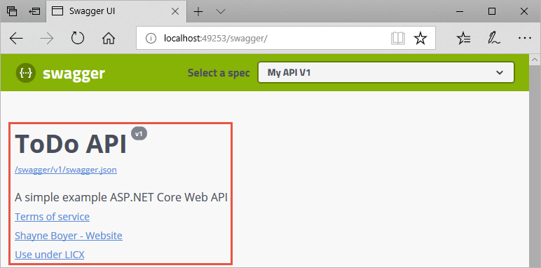
Documenting the object model - result
Notes:
The Swagger UI will display the same information that you configured in the object model.

Slide 27
XML comments
// update the .csproj file
<PropertyGroup>
<GenerateDocumentationFile>true</GenerateDocumentationFile>
<NoWarn>$(NoWarn);1591</NoWarn>
</PropertyGroup>
// register the Swagger generator
services.AddSwaggerGen(c =>
{
....
// Set the comments path for the Swagger JSON and UI.
var xmlFile = $"{Assembly.GetExecutingAssembly().GetName().Name}.xml";
var xmlPath = Path.Combine(AppContext.BaseDirectory, xmlFile);
c.IncludeXmlComments(xmlPath);
}
The XML comment file is used to generate documentation
Notes:
XML comment generation must first be enabled in Visual Studio by editing the .csproj file.
Next, you can update the object model’s configuration by using the IncludeXmlComments method.

Slide 28
Model attributes
public class TodoItem
{
public long Id { get; set; }
[Required]
public string Name { get; set; }
[DefaultValue(false)]
public bool IsComplete { get; set; }
}
Notes:
Decorate the model with attributes, found in the System.ComponentModel.DataAnnotations namespace, to help drive the Swagger UI components.
Add the [Required] attribute to the Name property of the TodoItem class. The presence of this attribute changes the UI behavior and alters the underlying JSON schema.

Slide 29
Controller attributes
[Produces("application/json")]
[Route("api/[controller]")]
[ApiController]
public class TodoController : ControllerBase
{
private readonly TodoContext _context;
....
}
Notes:
Add the [Produces("application/json")] attribute to the API controller. Its purpose is to declare that the controller's actions support a response content type of application/json.

Slide 30
Response descriptions - attributes
[HttpPost]
[ProducesResponseType(201)]
[ProducesResponseType(400)]
public ActionResult<TodoItem> Create(TodoItem item)
{
_context.TodoItems.Add(item);
_context.SaveChanges();
return CreatedAtRoute("GetTodo", new { id = item.Id }, item);
}
Notes:
Developers consuming the API are most concerned with what's returned—specifically response types and error codes (if not standard). The response types and error codes are denoted in the XML comments and data annotations.
The Create action returns an HTTP 201 status code on success. An HTTP 400 status code is returned when the posted request body is null.

Slide 31
Response descriptions – XML comments
/// <summary>Creates a TodoItem.</summary>
/// <remarks>
/// Sample request:
///
/// POST /Todo
/// {
/// "id": 1,
/// "name": "Item1",
/// "isComplete": true
/// }
///
/// </remarks>
/// <param name="item"></param>
/// <returns>A newly created TodoItem</returns>
/// <response code="201">Returns the newly created item</response>
/// <response code="400">If the item is null</response
Notes:
Without proper documentation in the Swagger UI, the consumer lacks knowledge of these expected outcomes.

Slide 32
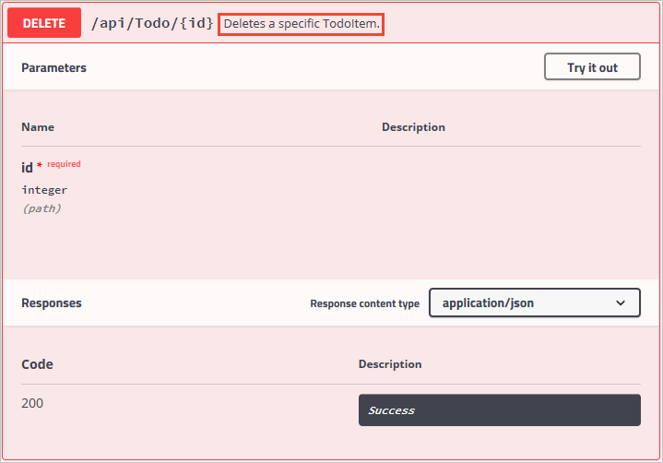
Swagger UI changes
Notes:
The Swagger UI now clearly documents the expected HTTP response codes.

Slide 33
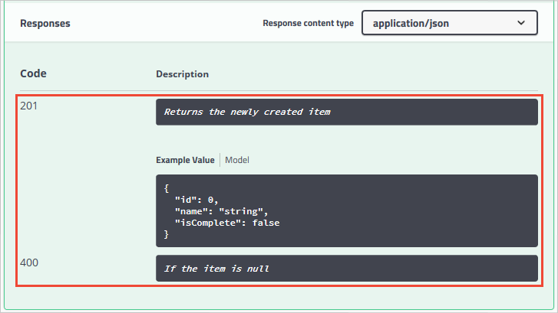
Swagger UI changes (continued)
Notes:
The Swagger UI now clearly documents the expected HTTP response codes.

Slide 34
Review
Azure API Apps
Creating API Management solutions
Using Swagger to document an API app
Notes:
These are the topics that we discussed in this module.

